Slide 1
Louisiana Baccarat
Baccarat Reimagined!

Slide 2
Can Baccarat really be improved?
Biggest Table Game in the world!
But it has some weird features that limit its appeal to some players:
  Rigid sequence of events, with seemingly arbitrary rules
  Unsatisfactory side bets
  Player cannot participate in the play, but is only betting on community hands
Any change needs to not lose any of the appeal to existing Baccarat players, and be consistent with the game’s “culture”
A key MATH INSIGHT allows a simplification that UNLOCKS numerous improvements
Full information and videos at LouisianaBaccarat.com

Slide 3
“The Core Math of Baccarat”
Community “Player” and “Banker” hands get 2 cards from a multi-deck “shoe”, select a 3rd according to fixed rules, winning hand has highest total after eliminating last digit of count (face cards = 0)
Banker hand draws 2nd and gets to use information of Player 3rd card in order to make a smarter decision about drawing
Bettors pick a hand to bet on, are paid even money, ties push, may also bet on a Tie or make other side bets
Banker 1.2% advantage means a mechanism must be defined to take some winnings away from the Banker.
E.G.: pay 19:20 odds on Banker win (“5% commission”), or define an event where Banker wins less (“EZ” Baccarat: Banker win with 3-card 7 is a push)

Slide 4
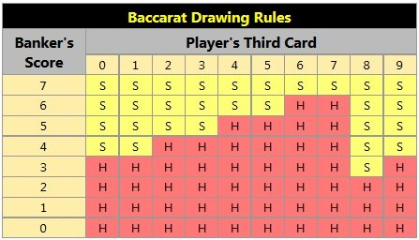
3rd Card Rule is the essence of the game
If either Player or Banker hand has an 8 or 9 after 2 cards, bets settled
Otherwise, Player draws 3rd card with 5 or less, stands pat on 6 or 7
If Player stood pat, Banker also draws on 5 or less, but if Player took a card Banker rule is complicated!

Slide 5
The “Key” insight “Unlocks” improvements!
The information about the Player’s 3rd card isn’t needed! Two thirds of the Banker advantage (0.8% out of 1.2%) comes not from knowing what that card was, but simply knowing whether the Player took one.
New Banker 3rd card rule: Hit 0-4, stand 6-7, and on 5 do the opposite of what the player did (Stand if he Hit, Hit if he Stood). No “table” needed.
Overall Player and Banker average House Edge is the same with 5% commission because Baccarat players play both bets equally
Improves game flow, allows for much better side bets, easier to understand and to train dealers, many incremental improvements
Plus a shocking bonus feature: Players may be offered the chance to play their own cards against the dealer as in Blackjack, instead of using a Community hand.
Designed as a casino floor game but electronic versions are easily adapted

Slide 6
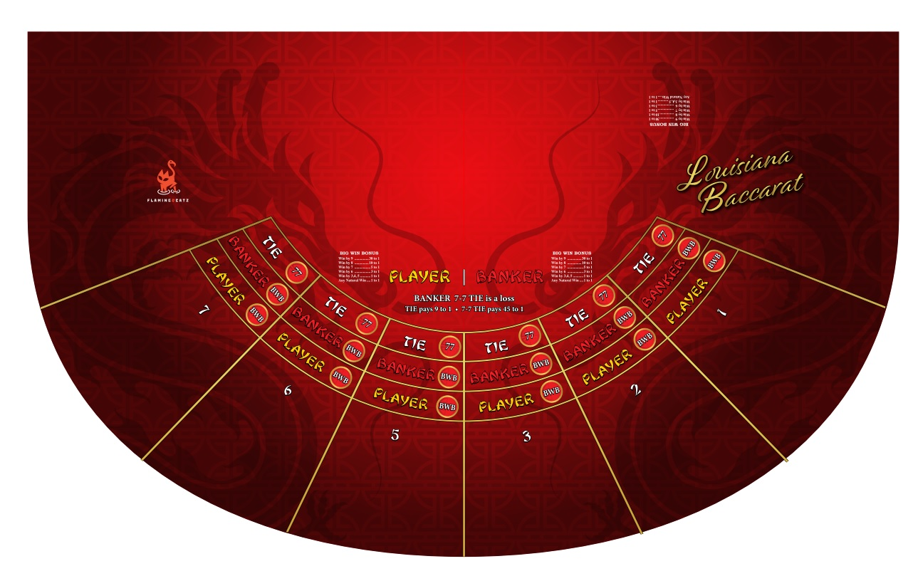

Slide 7
Side by Side Comparison (player’s point of view)
Louisiana Baccarat
Standard Baccarat
Commission free: 7-7 tie is a loss for Banker
Related side bet 45 to 1 if 7-7 tie
Big Win Bonus starts paying at “win by 3”
Tie Bet pays 9 to 1
Player bet better, Banker 3rd card use less info
Banker bet better, “exception” more natural, all wins are paid in full
Can deal cards either Player or Banker last
Easy to anticipate what happens next
Can play own cards when making Player bet
EZ Baccarat: Banker 3-card 7 win is a push
Related side bet 40 to 1 if Banker 3 card 7 win
Dragon Bonus starts paying at “win by 4”
Tie Bet pays 8 to 1
Complicated rule to make Player bet less good
Exception occurs more often (7-6 to 7-0 vs 7-7), feel cheated out of a win
Banker must go last, less exciting player reveal
3rd card rule confusing and hard to memorize
Must play community hands, no free will on 5

Slide 8
Side by Side Comparison (casino’s point of view)
Louisiana Baccarat
Standard Baccarat
Easier to train dealers, easy commission free and 3rd card rules, less confusing to players
Mini tables can play faster, 3rd cards together
All side bets correspond to main bets
Both sides of Big Win Bonus have 5 ½ % House Edge
4 configurations: Mini, Midi, Full size, Blackjack style
Attracts new players put off by Standard Bacc, but can keep existing Baccarat traditions too
Branding and marketing opportunities, high player retention due to favorable comparisons
Not all dealers can deal Baccarat
Less flexibility in order of play, fewer ways to accommodate “big players”
Arbitrary side bets
Dragon Bonus has big asymmetry in House Edge, 2% too low, 9% too high
Cannot offer Player vs Dealer configurations or give players free will to take 3rd card
Hard to sell to new players or offer something new to existing players
Anyone can offer, no one owns it so hard to gain competitive advantage

